Slide 1
Analysis For sales and revenue data

Slide 2
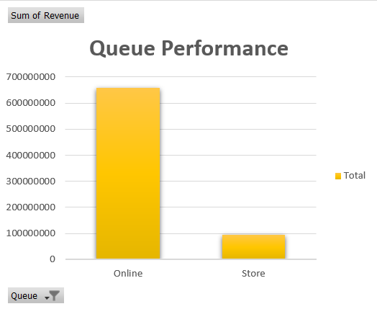
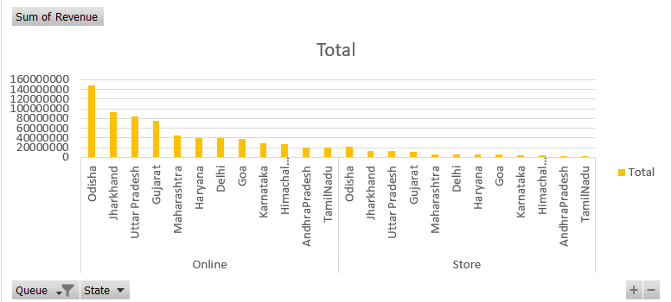
Queue Performance
It was observed that the ‘Online’ queue generated more revenue than Store.
The total revenue generated by Online platforms was more than 65 Cr.
State wise it can be seen that Odisha and Jharkhand had the best revenue collection in both the queues.

Slide 3
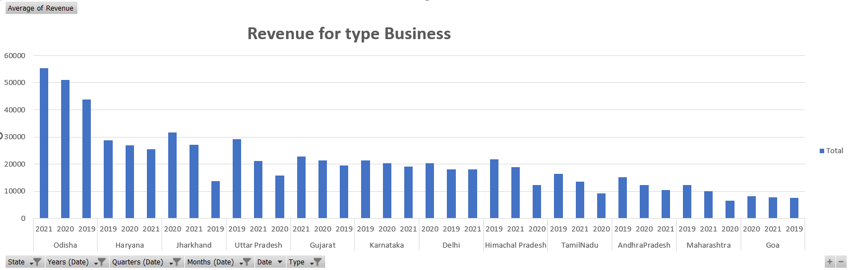
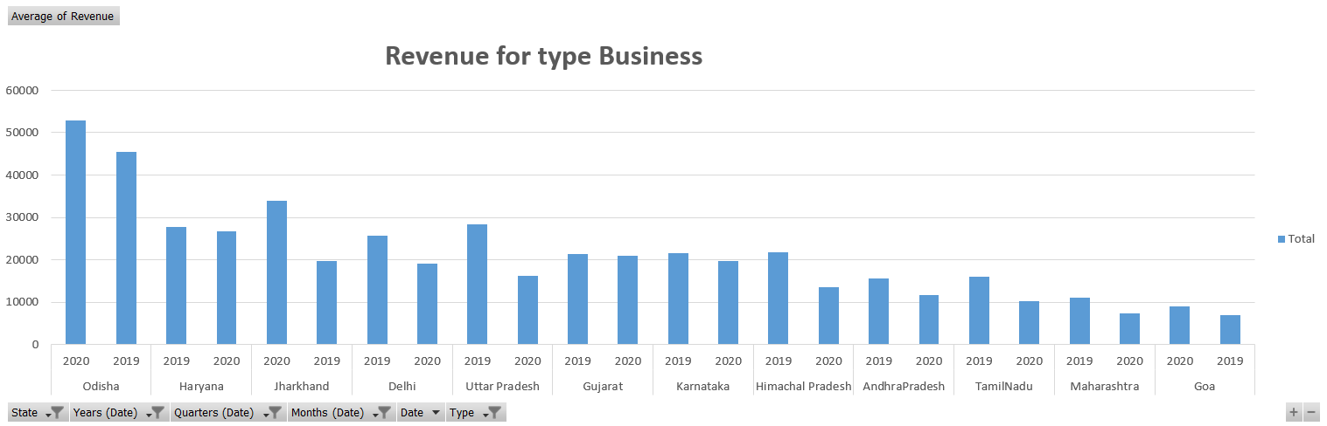
Revenue Analysis for type Business
Odisha and Haryana had the highest average revenue generated for Quarter 1 and Quarter 2 with Odisha generating highest revenue in 2021 and Haryana in 2019.
Same trends were observed for Quarter 3 and Quarter 4 with Odisha generating highest revenue in 2020 and Haryana in 2019.

Slide 4
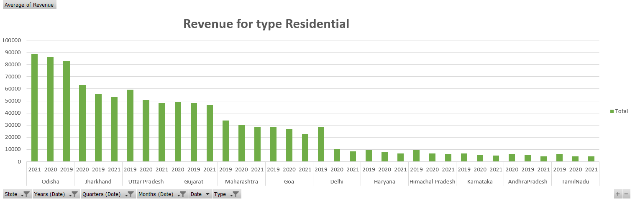
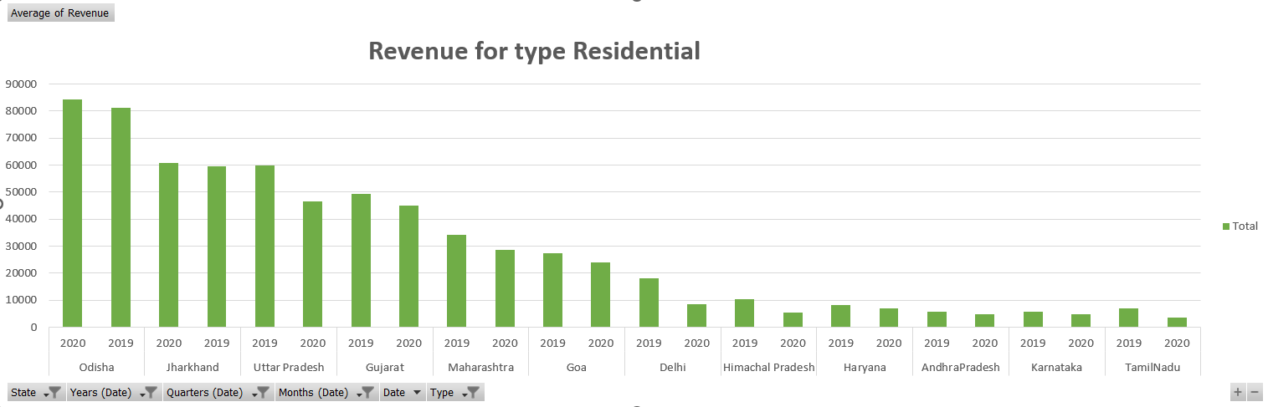
Revenue Analysis for type Residential
Odisha and Jharkhand had the highest average revenue generated for Quarter 1 and Quarter 2 with Odisha generating highest revenue in 2021 and Haryana in 2020.
Same trends were observed for Quarter 3 and Quarter 4 with Odisha generating highest revenue in 2020 and Jharkhand in 2020.

Slide 5
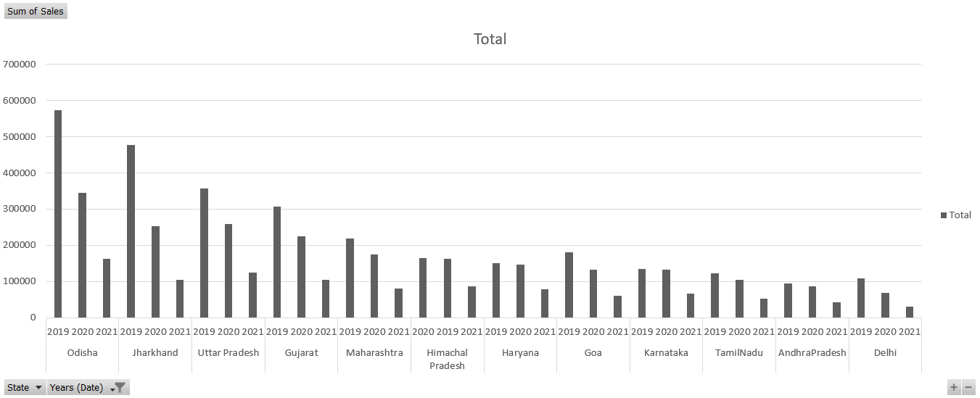
Sales Trends
Odisha and Jharkhand had the highest Sales generated just like in case of revenue.
Also it can be seen from the graph that all the states generated higher sales before Covid except Himachal Pradesh that had the performed better in terms of Sales during Covid.

